Slide 1



Integer Range Analysis
Maglione Sandro
June 29th, 2020
High Performance Processors and Systems | UIC 569

Slide 2

Context
Source codes are made of millions of lines of code, problem of memory and resources!

Slide 3
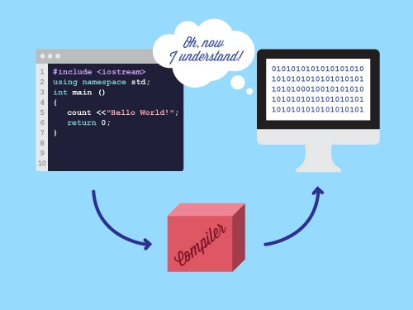
Context
Optimization of resources using compiler and static analysis

Slide 4

Context
Bitwidth analysis, reduce number of bits allocated for each variable

Slide 5


How to optimize?
Static analysis, reduce memory usage while keeping the code correctness

Slide 6
Value Range Analysis
a {32bit}
b {16bit}
144bit
c {32bit}
d {64bit}

Slide 7

Value Range Analysis
a {32bit}
b {16bit}
c {32bit}
d {64bit}

Slide 8
Value Range Analysis
a {32bit}
a {16bit}
b {16bit}
b {8bit}
c {32bit}
c {8bit}
d {64bit}
d {16bit}

Slide 9
Value Range Analysis
a {16bit}
b {8bit}
48bit
c {8bit}
d {16bit}

Slide 10
Purpose
a
{Min=0, Max = 20}
a {32bit}
a {6bit}
Infer the minimum and maximum value, compute number of bits

Slide 11

LLVM
Open-source compiler infrastructure project
Intermediate representation (IR)
LLVM Pass Framework
Transformations
Optimizations
Analysis

Slide 12
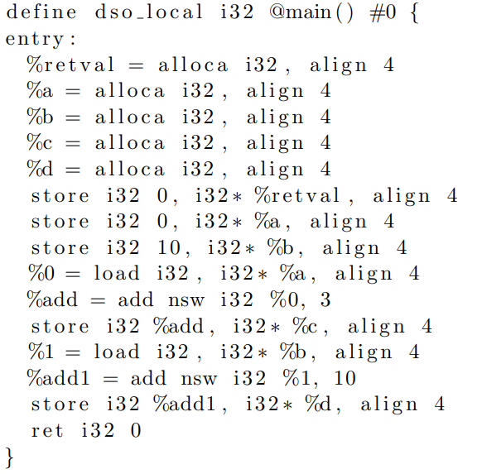

LLVM

Slide 13
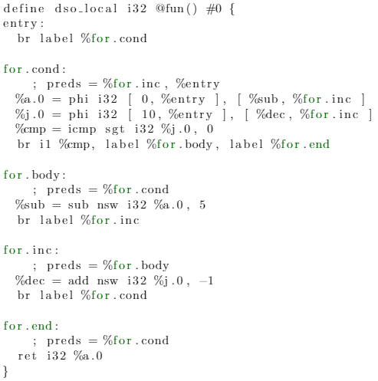
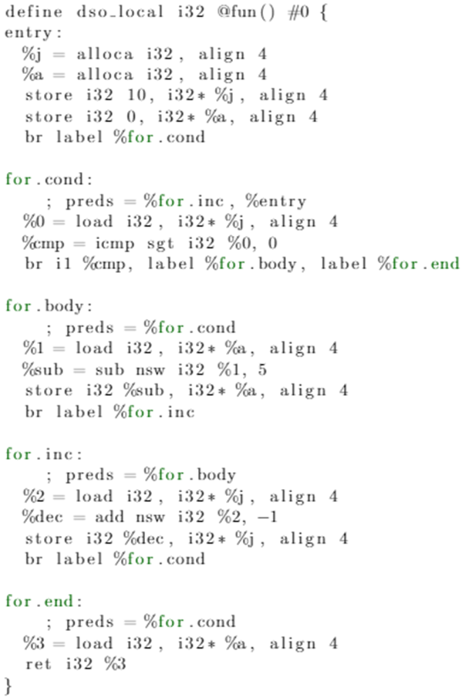
LLVM

Slide 14
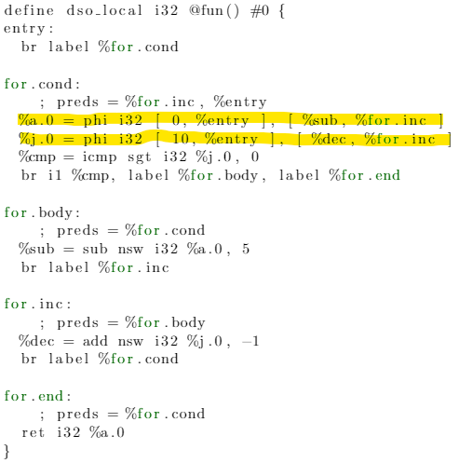
LLVM

Slide 15
Methodology
Source Code
In C language
Convert C file in bitcode format (.bc)
LLVM mem2reg, constprop, dce, simplifycfg, and gvn
Report results obtained
Run Range Analysis Pass on IR
Optimized IR in ‘pruned’ SSA form

Slide 16
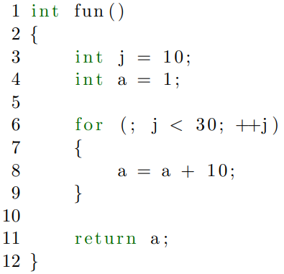
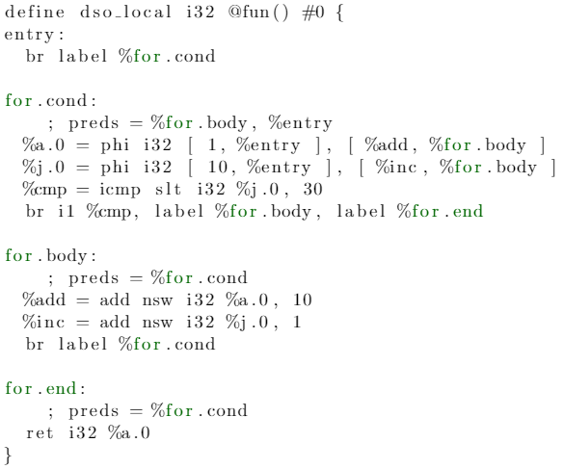
Execution

Slide 17
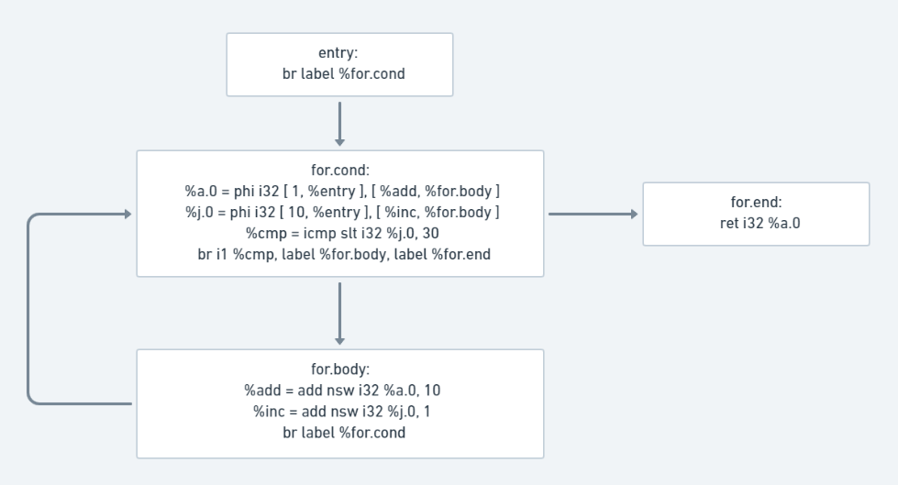
Execution

Slide 18
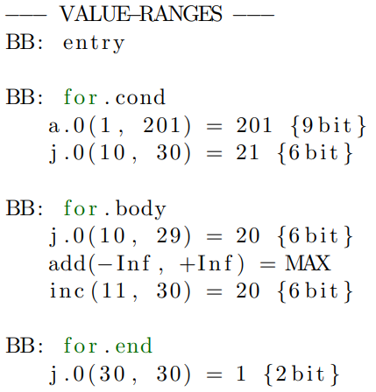
Execution

Slide 19
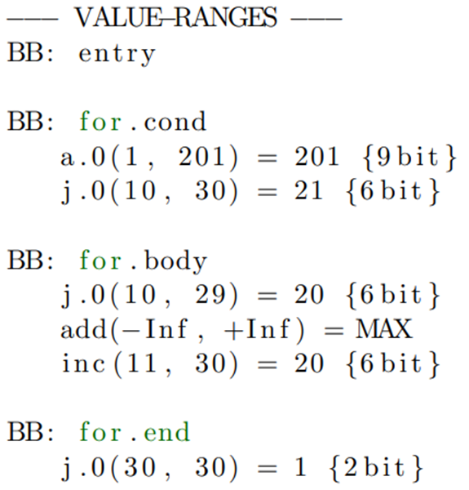
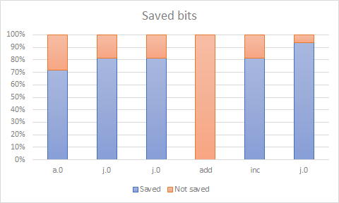
Experimental Results
Performance achieved on the example source code.

Slide 20
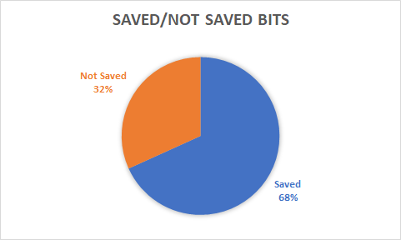
Experimental Results
Performance achieved on the example source code.

Slide 21
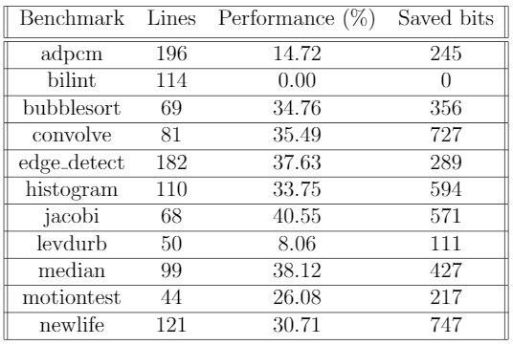
Experimental Results
Performance achieved on the bitwise benchmark set.

Slide 22
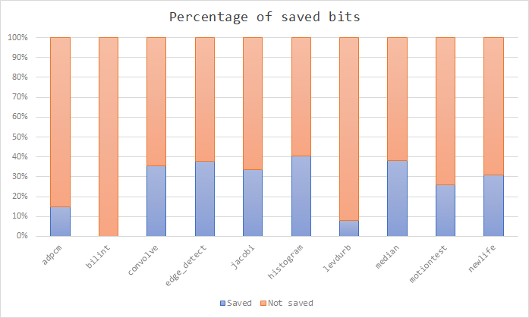
Experimental Results
Performance achieved on the bitwise benchmark set.

Slide 23
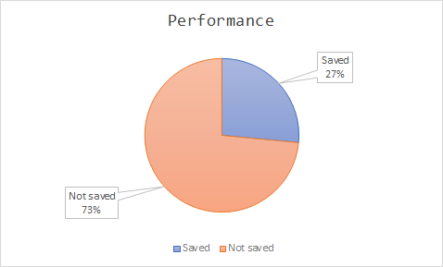
Experimental Results
Performance achieved on the bitwise benchmark set.

Slide 24
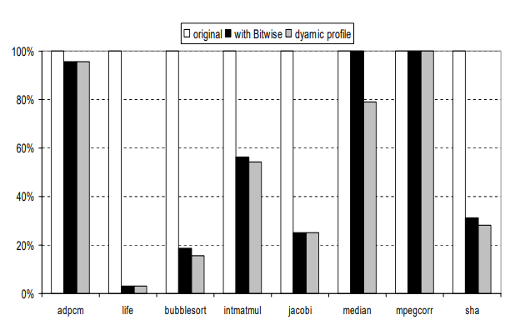
Related Works
A Fast and Low-Overhead Technique to Secure Programs Against Integer Overflows Fernando Magno Quintao Pereira Raphael Ernani Rodrigues Victor Hugo Sperle Campos
The Design and Implementation of a Non-Iterative Range Analysis Algorithm on a Production Compiler Douglas do Couto Teixeira and Fernando Magno Quintao Pereira
Bitwidth Analysis with Application to Silicon Compilation Mark Stephenson Jonathan Babb and Saman Amarasinghe
Eliminated 24.93% of the integer overflow checks
Increased 1-bit variables by 1.04x, 8-bit variables by 52.3x and 16-bit variables by 26.6x

Slide 25

Maglione Sandro
10532096 – 940807
674339166
sandro.maglione@mail.polimi.it

